Slide 1

National 4: Heroes
6) Explode a graphic novel
Comics are hard work. Comics are relentless. Comics will break your heart. Comics are monetarily unsatisfying. Comics don’t offer much in terms of fortune and glory, but comics will give you complete freedom to tell the stories you want to tell, in ways unlike any other medium.
Becky Cloonan

Slide 2
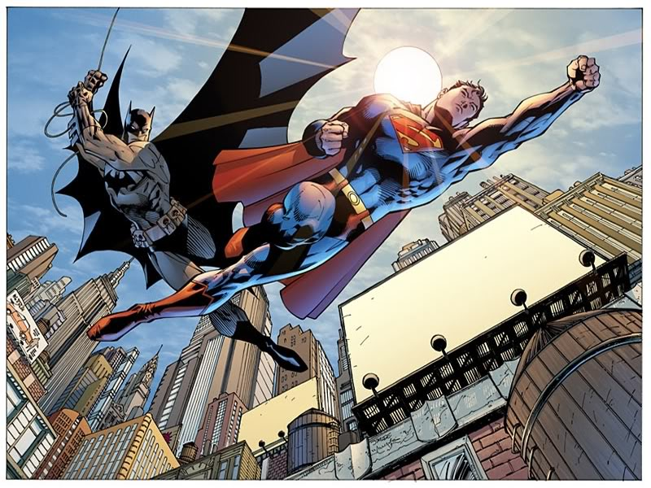
We are learning to:
We are learning to analyse the feature, specifically images and text, used within a graphic novel.
Success Criteria:
I can identify and explain the
features of a specific graphic novel

Slide 3
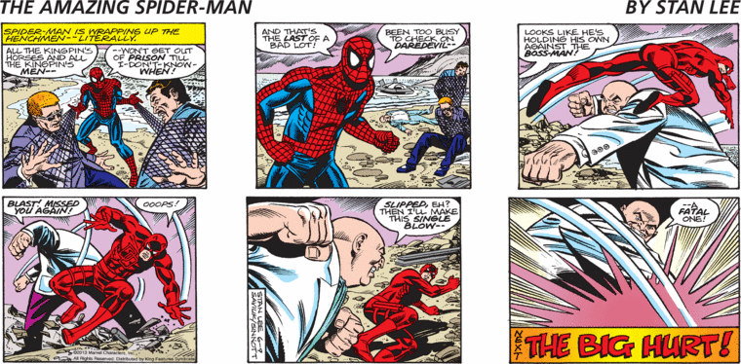
What makes up a comic strip?
Text Box
Speech
Bubble
Gutter
Label each part of your comic strip.
Panel

Slide 4
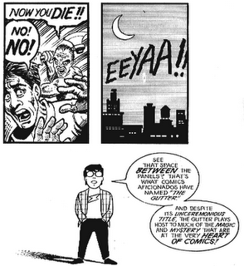
Analysing layout: the gutter
The space between panels is called the gutter. This space is actually important – as it allows the cartoonist to tell the story in a shorter, more condensed way.
It relies on the reader (YOU!) to use your imagination to fill in the gap in the story.
Closure = The process by which the mind fills in mising details between the panels of a comic
For example – we do not know who is screaming or how the axe was used but we all have an image in our mind

Slide 5
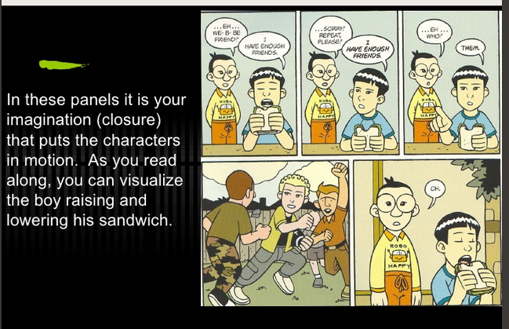
Analysing layout: the gutter

Slide 6
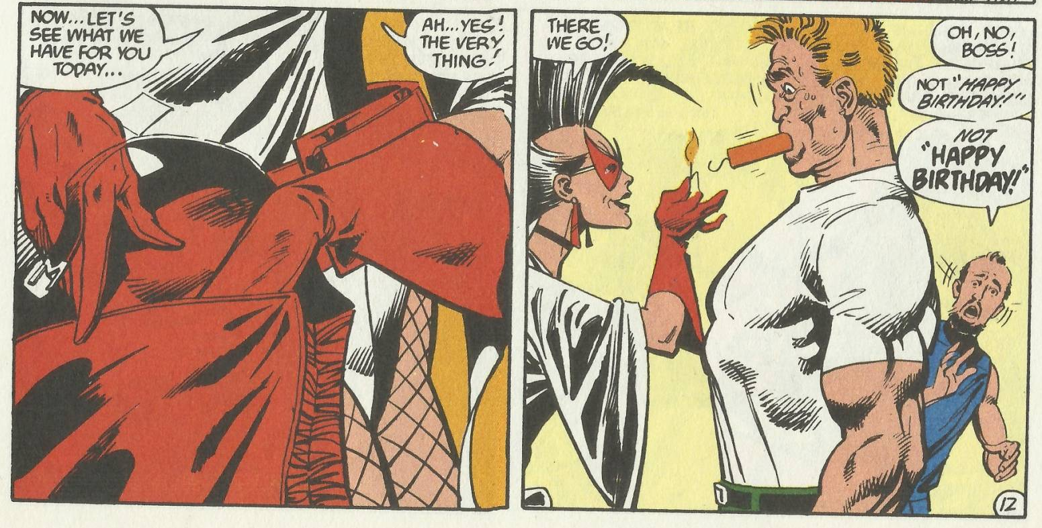
Analysing layout: the gutter
Task:
Look at your comic strip – identify three times when the gutter is used to move the story on. Write down what you think happens in the gap between panels
The gap between the two panels makes me think the woman got a stick of dynamite out of her bag and stuck it in the man’s mouth.

Slide 7
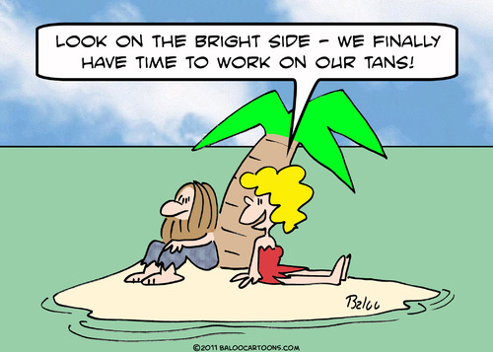
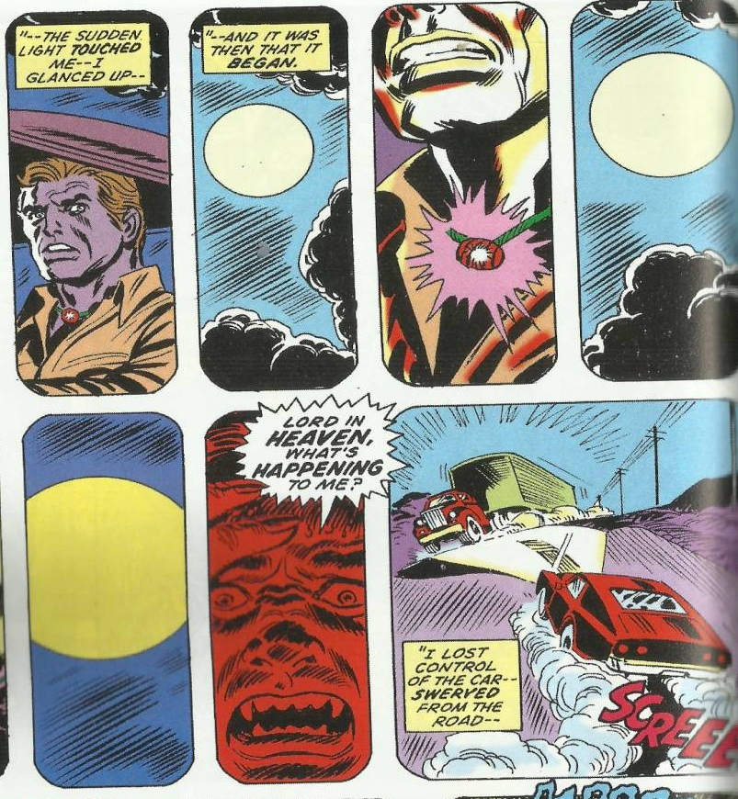
Analysing layout: Size of Panel
A single panel comic, like this one, cannot tell us a lot about time scale – a single panel is one moment in time.
But cartoonists can experiment with the size of the panel to show differences in time. This strip uses small panels to show how quickly the events are happening.

Slide 8
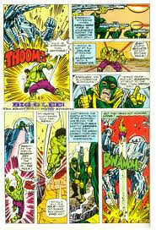
Analysing layout: Size of Panel
Panel size can also be altered to show movement (like the Hulk jumping up to punch the robot) or to emphasise a detail (the guns of the henchmen)

Slide 9
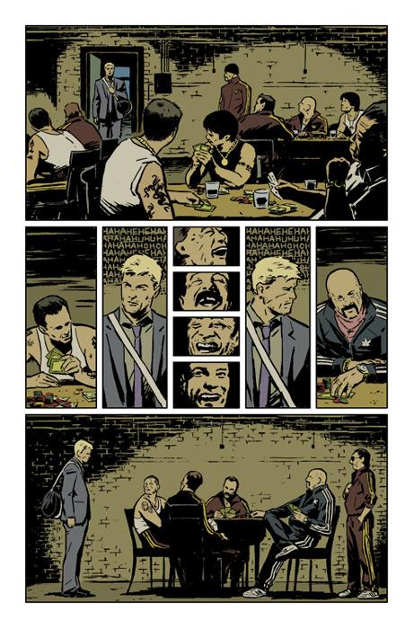
Analysing layout: size of panel
Task:
Look at your comic strip – identify two different sized panels and why you think they have been used
The small panels shows how the different men are laughing at what is being said.

Slide 10
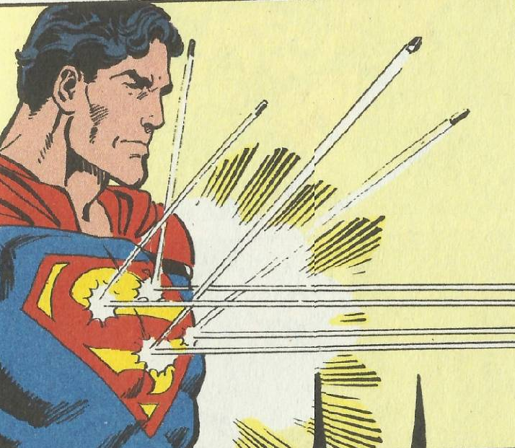

Analysing visuals: the characters
Task:
Using your prior knowledge about superheroes write down what each image tells you about Superman and Batman

Slide 11
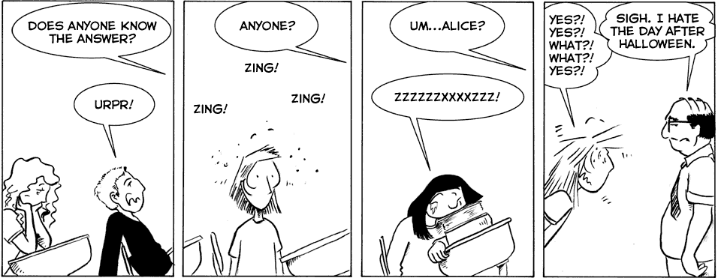
Analysing visuals: emotions
With only a few lines a cartoonist can convey a vast range of emotions
Task:
Identify the emotions displayed by the characters in your comic strip and say how you know this
For example we know this girl is bored because her mouth is downturned and she has her head on her hands

Slide 12
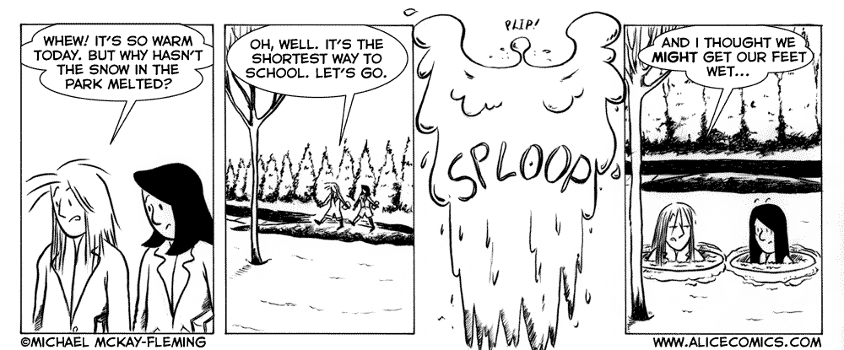
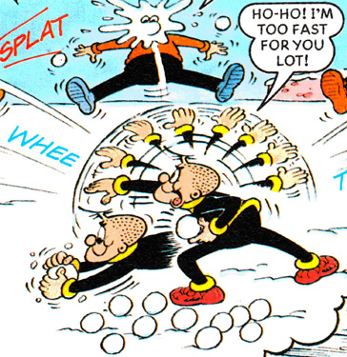
Analysing visuals: showing movement
A comic strip is just a series of static images and yet they are able to convey movement through MOTION LINES.
Task:
Identify where motion lines are used in your comic strip and what movement they are showing.

Slide 13
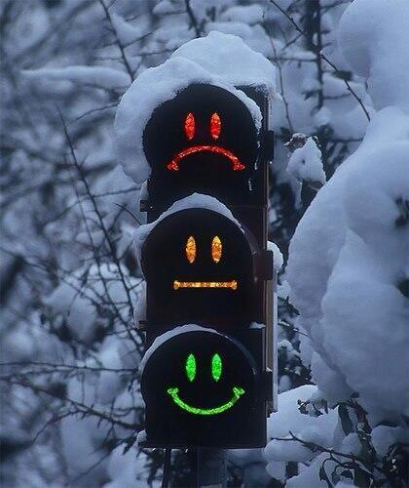
Consolidation: Graphic novel analysis
In your groups evaluate your work on comic strips. Beside your notes write:
A ☺ for something that you did well
A 😐 for something you could have improved
A ☹ for something that you did not do well.

